Slide 1
Alert and Action
Microsoft Power Platform
Govern
&
Grow
1. Secure
2. Monitor
3. Alert and Action
4. Deploy
5. Nurture
6. Infrastructure
7. Support

Slide 2
Alert and Action: What we plan to cover
1. Secure
2. Monitor
3. Alert and Action
4. Deploy
Product discovery: understand the origin of apps & flows | Review out-of-box analytics | Leverage management connectors & PowerShell to automate your policies | Understand managed vs unmanaged solutions
Know your environments | Configure audit logs | Welcome new makers and foster best practices | Learn the Application Lifecycle Management (ALM) toolset and best practices
Learn the 5 layers of security + the one that maters most | Leverage management connectors & PowerShell as powerful reporting tools | Identify and empower champions
Setup data loss prevention policies

Slide 3
Now let’s alert and action
1. Secure
2. Monitor
3. Alert and Action
4. Deploy

Slide 4
Scenarios
Get notifications when resources are created and follow-up actions with app creators
Drive company policies
Automate environment creation

Slide 5
Automate with PowerShell cmdlets
The PowerShell Cmdlets place full control in the hands of admins to automate the governance policies necessary - aka.ms/powerappspowershell.
Separate cmdlets for app creators and administrators
Can be used with other service to automate full processes
e.g. Create User, Assign License, Create Environment all in one script

Slide 6
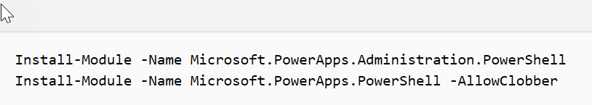
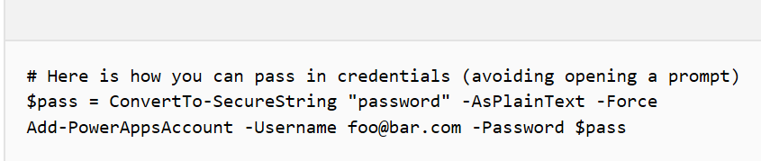
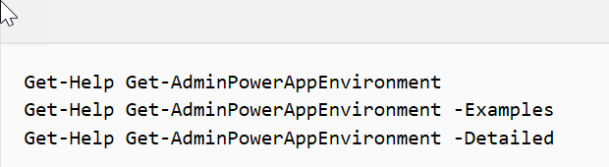
Getting started with PowerShell
Installing
Setting Credentials
Exploring Help
https://docs.microsoft.com/power-platform/admin/powerapps-powershell#powerapps-cmdlets-for-administrators-preview
Notes:
credentials are refreshed for up to ~8 hours before you’re required to sign in again to continue using the cmdlets.

Slide 7
Working with Environments and CDS
Environments
CDS
New-AdminPowerAppEnvironment
Set-AdminPowerAppEnvironmentDisplayName
Get-AdminPowerAppEnvironment
Get-AdminPowerAppEnvironmentLocations
Remove-AdminPowerAppEnvironment
New-AdminPowerAppCdsDatabase
Get-AdminPowerAppCdsDatabaseLanguages
Get-AdminPowerAppCdsDatabaseCurrencies

Slide 8
Working with Power Apps Canvas apps
Canvas Apps
Canvas Permissions
Get-AdminPowerApp
Remove-AdminPowerApp
Get-AdminPowerAppConnectionReferences
Set-AdminPowerAppAsFeatured
Clear-AdminPowerAppAsFeatured
Set-AdminPowerAppAsHero
Clear-AdminPowerAppAsHero
Set-AdminPowerAppApisToBypassConsent
Clear-AdminPowerAppApisToBypassConsent
Get-AdminPowerAppRoleAssignment
Remove-AdminPowerAppRoleAssignment
Set-AdminPowerAppRoleAssignment
Set-AdminPowerAppOwner

Slide 9
Working with Microsoft Flow
Flow
Flow Permissions
Get-AdminFlow
Enable-AdminFlow
Disable-AdminFlow
Remove-AdminFlow
Remove-AdminFlowApprovals
Get-AdminFlowOwnerRole
Set-AdminFlowOwnerRole
Remove-AdminFlowOwnerRole
Flow Approvals
Get-FlowApprovalRequest
Get-FlowApproval
RespondTo-FlowApprovalRequest

Slide 10
Working with Connectors
Connectors
Permissions
Get-AdminPowerAppConnection
Remove-AdminPowerAppConnection
Get-AdminPowerAppConnectionRoleAssignment
Set-AdminPowerAppEnvironmentConnectionRoleAssignment
Remove-AdminPowerAppConnectionRoleAssignment
Notes:
Same methods apply to custom connectors as well

Slide 11
Working with other tenant resources
Users
Data Loss Prevention
Get-AdminPowerAppsUserDetails
Get-AdminFlowUserDetails
Remove-AdminFlowUserDetails
Get-AdminDlpPolicy
New-AdminDlpPolicy
Remove-AdminDlpPolicy
Set-AdminDlpPolicy
Add-ConnectorToBusinessDataGroup
Remove-ConnectorFromBusinessDataGroup
Add-CustomConnectorToPolicy
Remove-CustomConnectorFromPolicy
Tenant Settings
Get-TenantSettings
Set-TenantSettings
$settings = @{ DisableEnvironmentCreationByNonAdminUsers = $true }
Set-TenantSettings $settings
Environment creation setting just launched in May ‘19

Slide 12




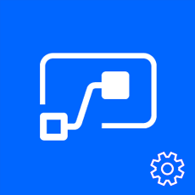
Leverage management connectors & PowerShell
powerful reporting tools + tools for action
Management connectors
Full visibility: Power Platform APIs in an accessible connector interface, provide admin access to resources
Customization : Pull the metadata you need to build the custom reports you want
Flexibility: Build the policies you need to implement administration + governance requirements
PowerApps for Admins
PowerApps for App Makers
Power Platform for Admins
Microsoft.PowerApps. Administration.PowerShell
Flow Management
Microsoft.PowerApps.PowerShell
The PowerShell Cmdlets give admins full visibility to all activity for Power Apps and Flow in their organization - aka.ms/powerappspowershell.

Slide 13
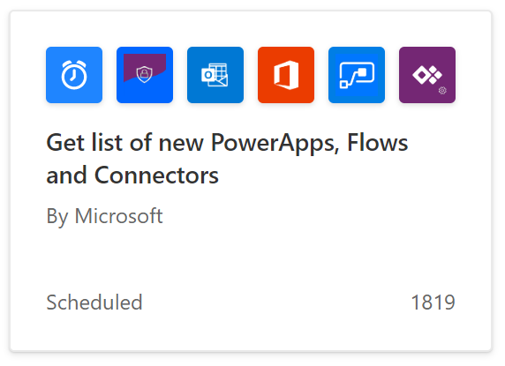
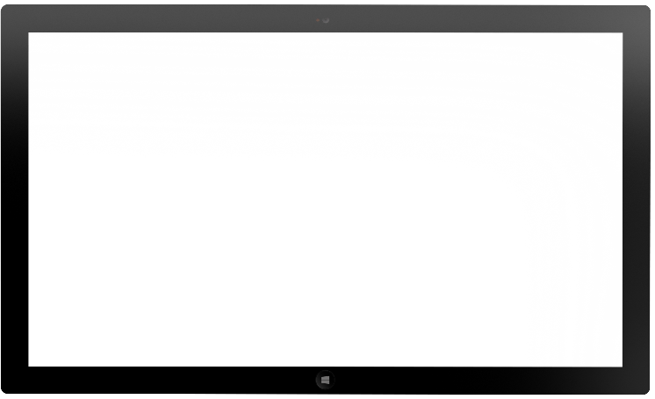
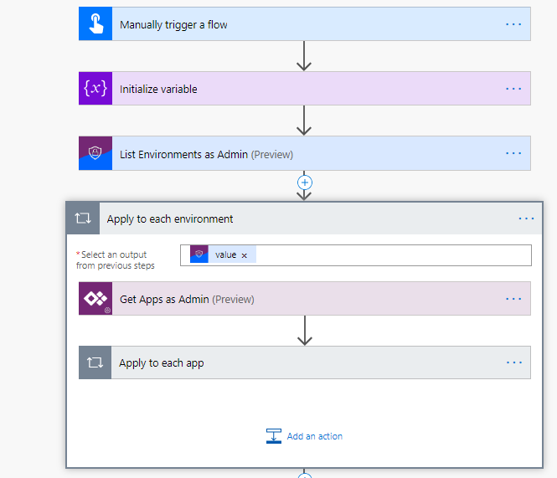
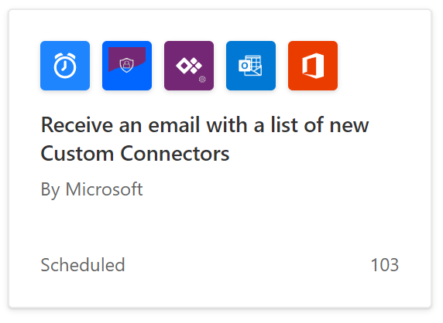
Leverage management connectors
Notes:
Show screenshot or demo if attendees are unfamiliar with what Flow looks like

Slide 14
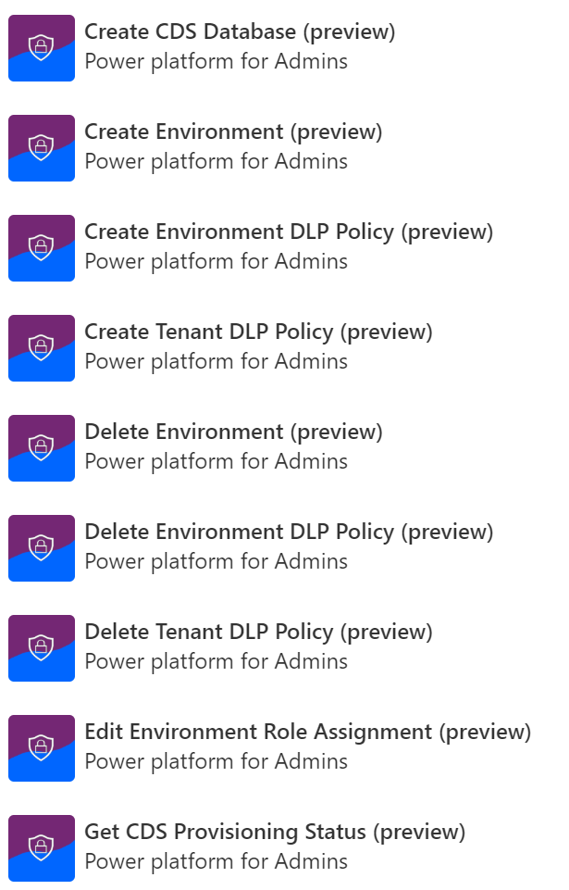
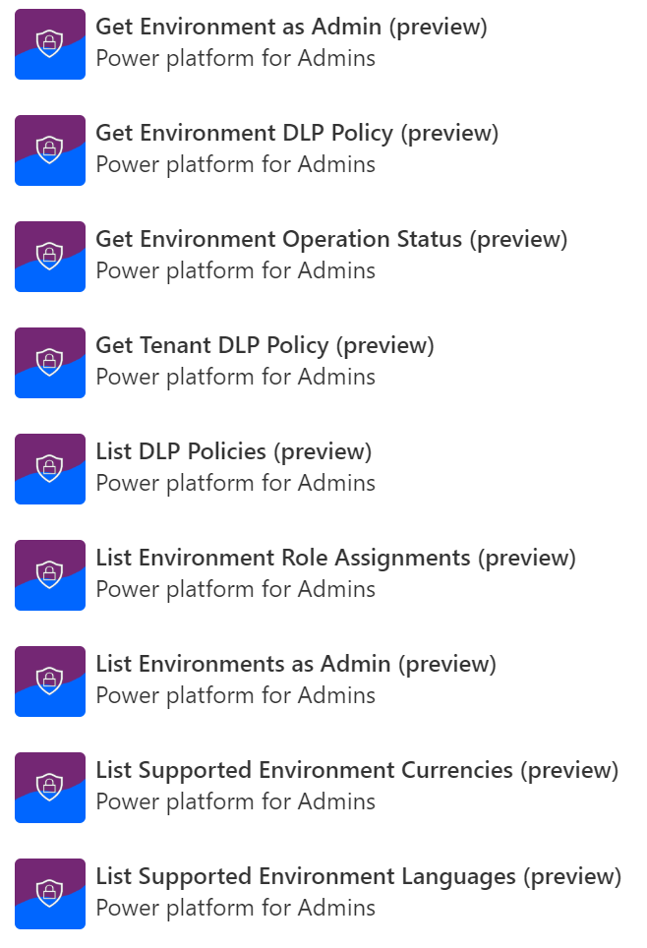
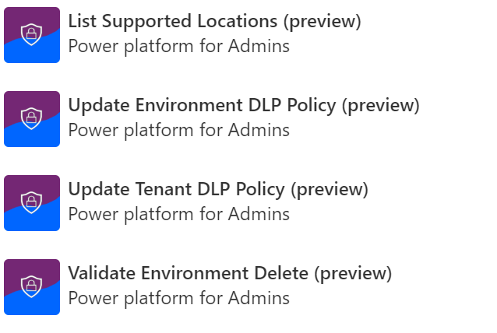
Power Platform for Admins

Slide 15
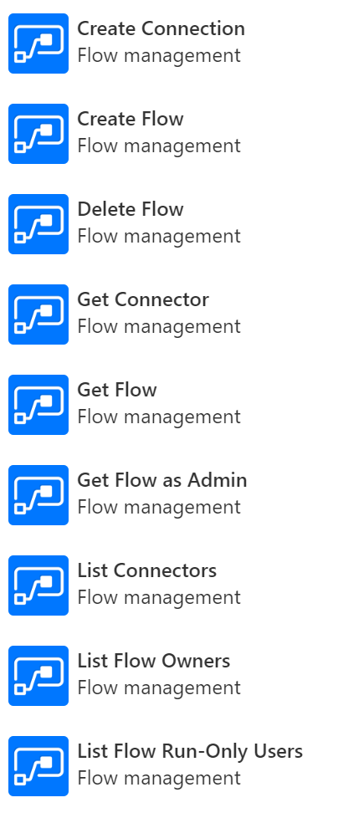
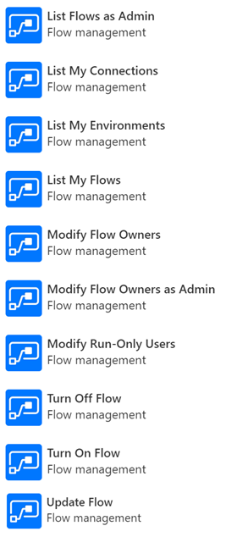
Flow Management

Slide 16
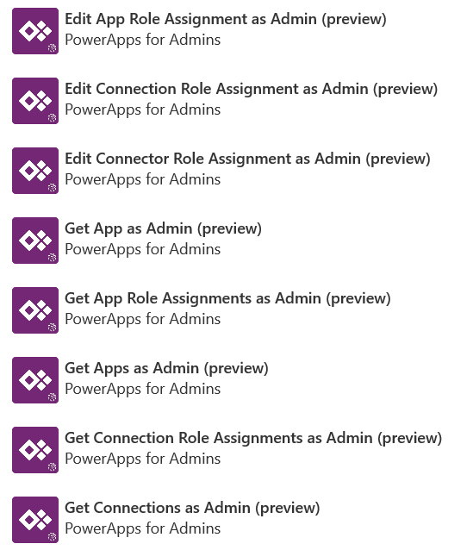
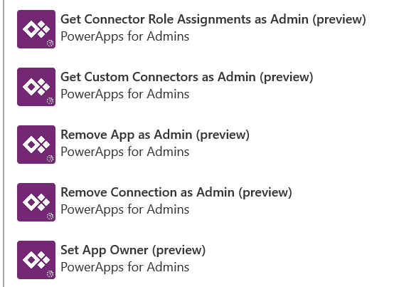
PowerApps for Admins

Slide 17
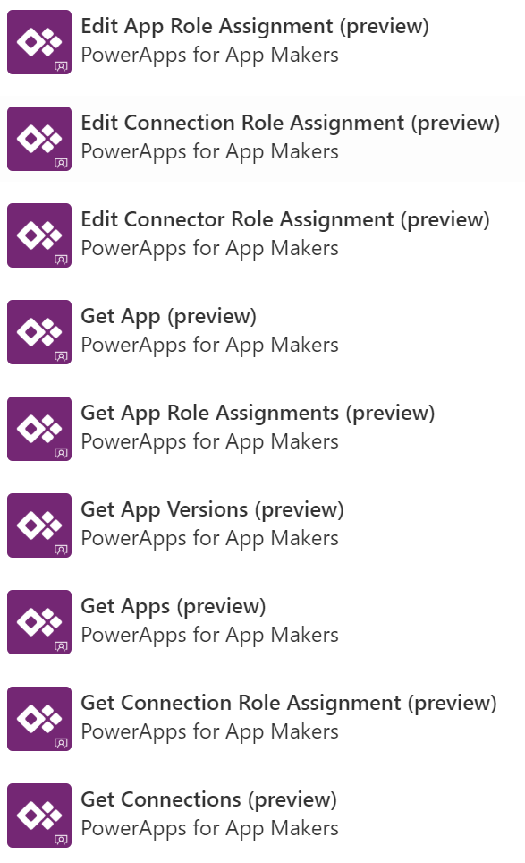
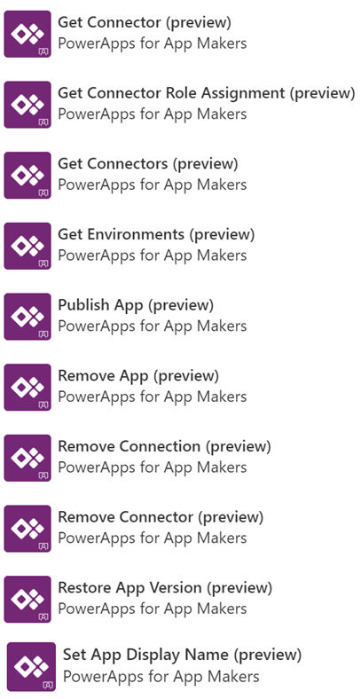
PowerApps for Makers

Slide 18

Automate audit and governance
Create your own workflows using the management connectors that permit or restrict behavior based on your organization’s policies
.
Easier task with PowerShell
Pull numbers of environments, apps, and flows
Bulk create multiple environments with CDS
Cleaning up environments no longer needed
Change owner of app after someone leaves
Report how many using premium connectors or
data gateways
Easier task with Management connectors
Build your own admin Power App
Automate environment creation with approvals
Get alerts when new resources are created
Create your own governance processes for:
Environment creation | aka.ms/restrictedenvcreators
Canvas app, workflow creation | aka.ms/restrictappcreators
Specific connector usage | aka.ms/restrictflowconnector aka.ms/restrictappconnector
Newly added connectors | aka.ms/newconnectornotification

Slide 19
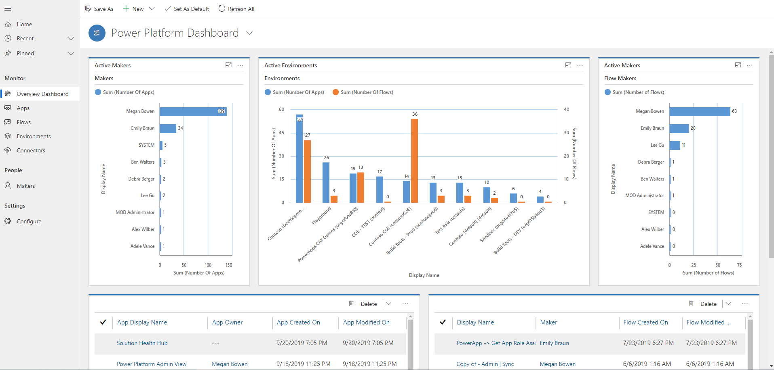
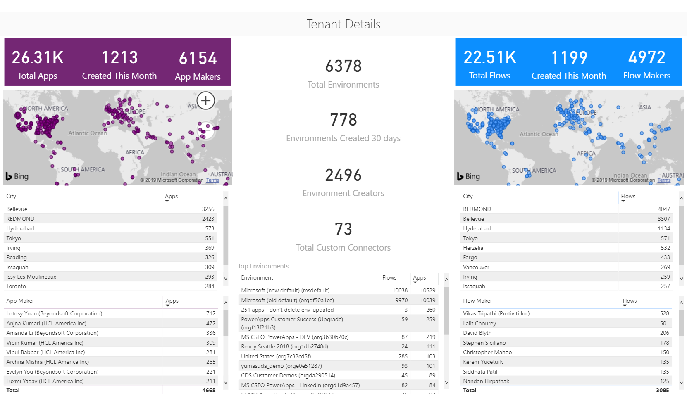
Don’t start from scratch… Install Center of Excellence Toolkit
Download here now https://aka.ms/COEStarterKit
Solution | Scenario
Core Components | Catalogue tenant resources DLP Strategy and Visibility Change App Ownership
Compliance Components | Sample App Audit Process Archive unused apps Act based on certain connector usage
Nurture Components | Onboard new makers, provide training and share best practices Encourage Adoption

Slide 20
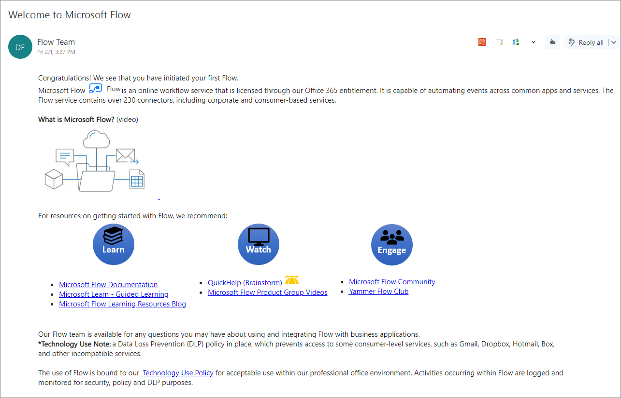
Welcome new makers and identify champions
Welcome new makers
Detect when new flow has been created
Check to see if they are part of makers AAD Group
If new, send welcome email with company and public resources
Invite them to Internal Yammer Club
https://aka.ms/powerwelcomeemail

Slide 21
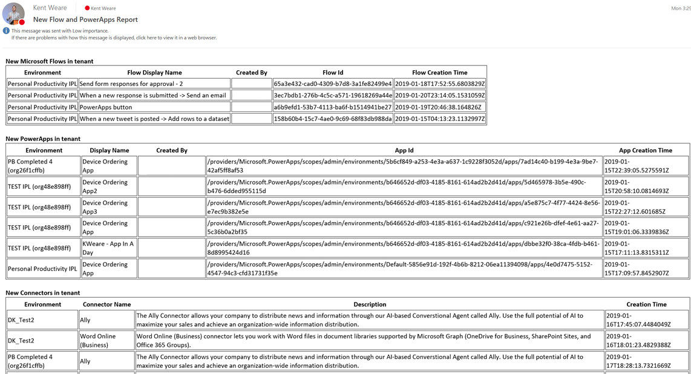
Welcome new makers and identify champions
Welcome new makers
Detect when new flow has been created
Check to see if they are part of makers AAD Group
If new, send welcome email with company and public resources
Invite them to Internal Yammer Club
https://aka.ms/powerwelcomeemail
Identify champions
New Flow, Power Apps and Connectors Digest
Sent Daily
Oversight
Empower new users
https://aka.ms/newmakerdigest

Slide 22
Establish and automate your audit process
Best
Practice
#3
Create your own workflows using the management connectors that permit or restrict behavior based on your organization’s policies (e.g. create an attestation process for assets in the default env)
Canvas app, flow creation | aka.ms/restrictappcreators
Specific connector usage | aka.ms/restrictflowconnector aka.ms/restrictappconnector
Newly added connectors | aka.ms/newconnectornotification

Slide 23
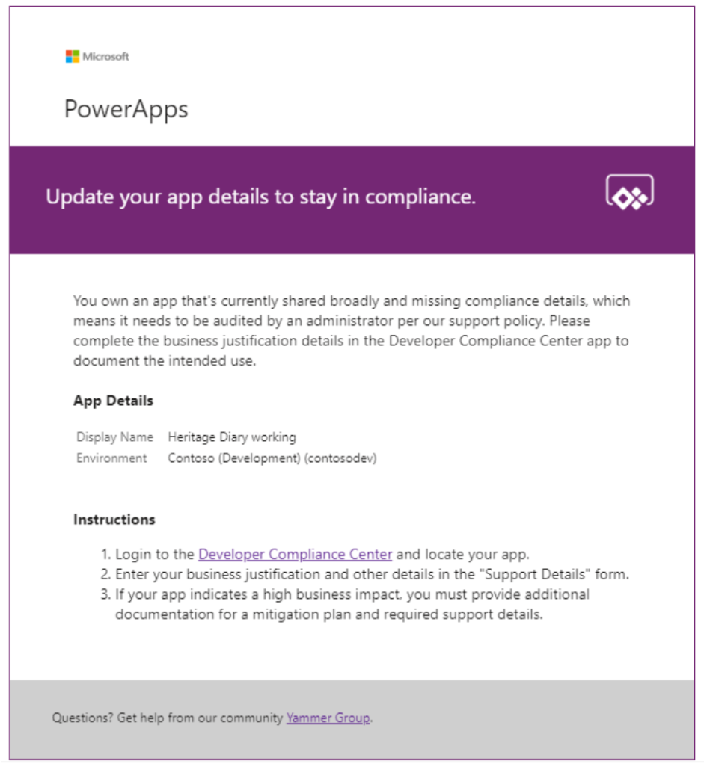
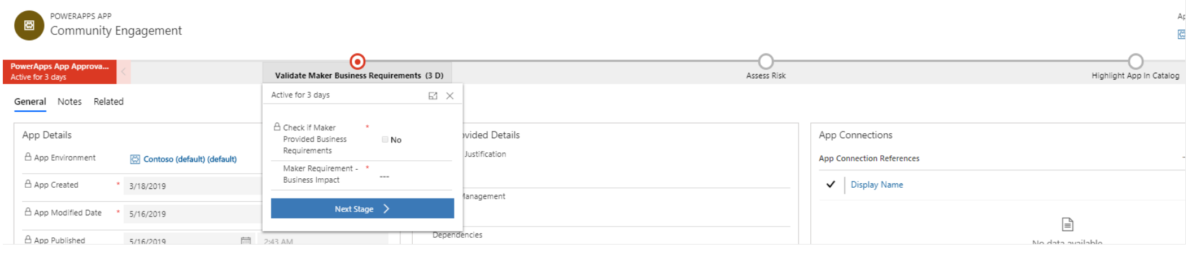
Establish and automate your audit process
Best
Practice
#4
Create your own workflows using the management connectors that permit or restrict behavior based on your organization’s policies (e.g. create an attestation process for assets in the default env)
CoE starter kit comes with its own audit workflow:
Apps are identified by a flow based on criteria such as the app is shared with > 20 Users or at least 1 group and the business justification details have not been provided.
Developer Compliance Center where the maker can provide a justification
Admin business process workflow for approval

Slide 24
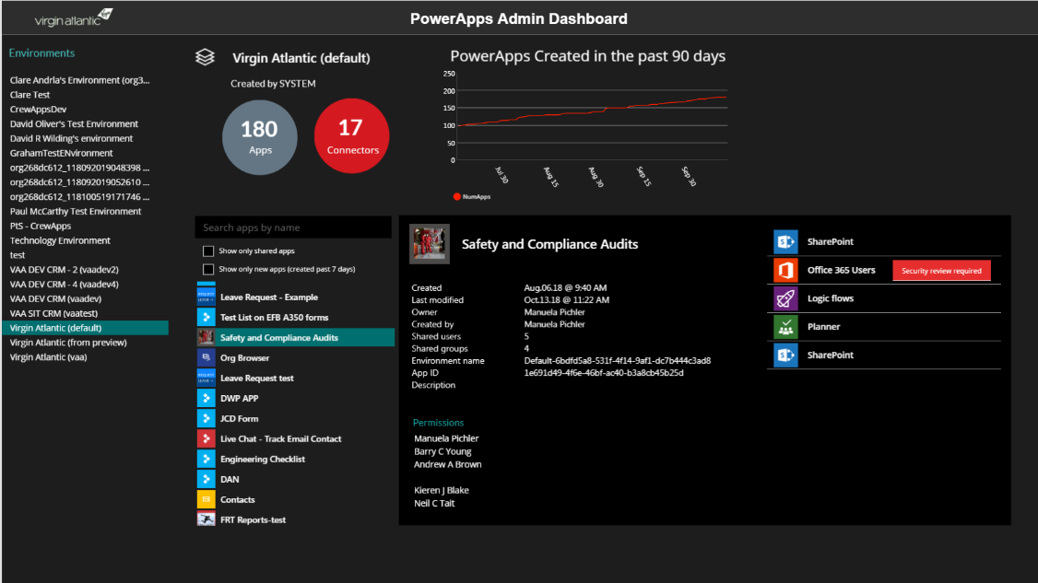
“An app to rule all Power Apps” (Virgin Atlantic)
Top level stats - # of apps, connectors, and app growth
List of environments
App details
Creator
Date created
Who is the app shared with
Description
…and more
Search and filter
show only shared apps
show new apps
List all connectors used by the app
List all apps in the environment
This is a Power Apps app that uses the Power Apps Admin connectors – http://aka.ms/adminconnectors

